Slide 1
Today’s topics
Casting
Polymorphism
Abstraction
Interfaces
Anonymous classes
SWING
Project lifecycles
Requirements gathering

Slide 2
Casting Primitives
Implicit – can only be used when casting to a larger type
byte -> short -> int -> long -> float -> double
Explicit
int i=34; double d; d=i;
int i=34; double d; d=(int)i;

Slide 3
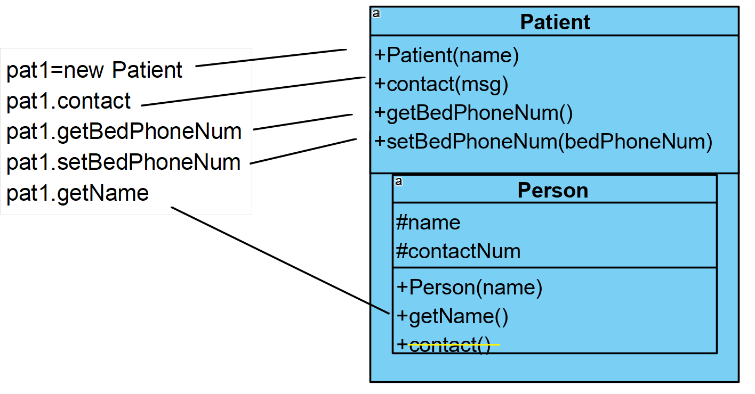
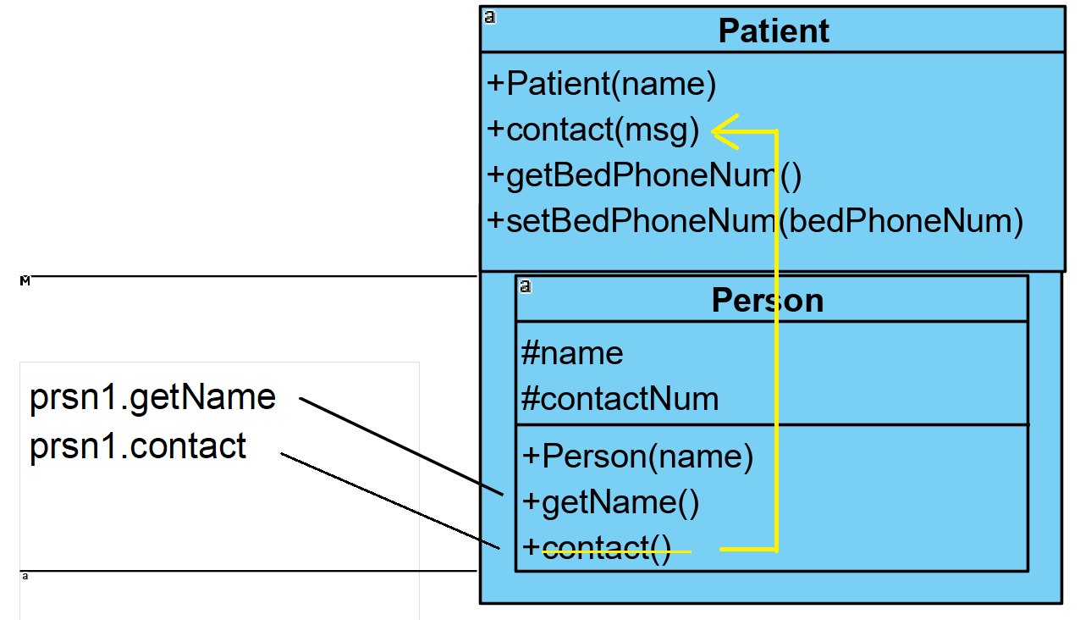
Casting Objects
Can explicitly cast subclasses to superclasses
Patient pat1=new Patient(“John Smith”); Person prsn1=(Person)pat1;

Slide 4
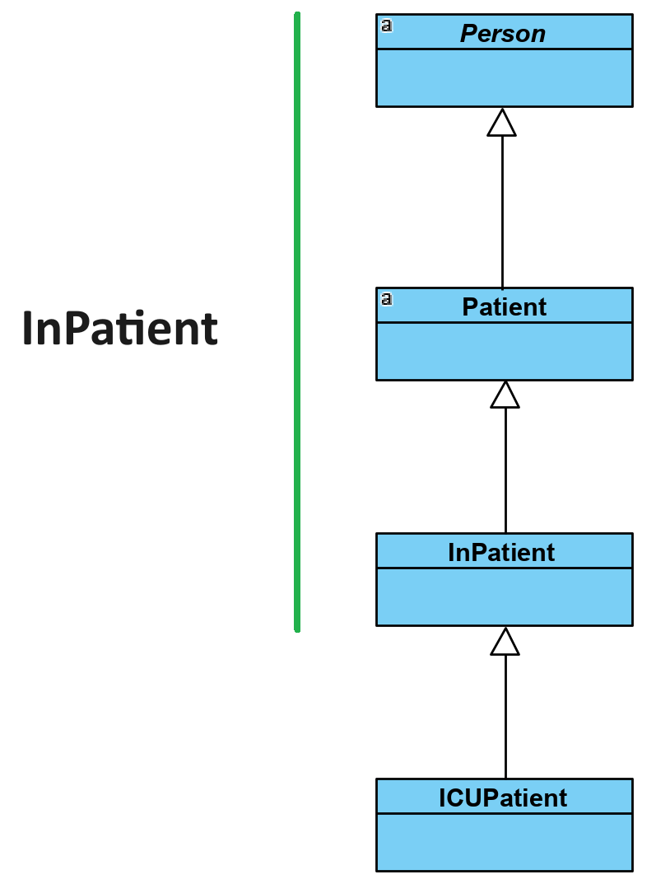
Casting Objects
Can cast from subclass to superclass and back again

Slide 5
Polymorphism
‘Many shapes’
To interact with different things in the same way
Subtype polymorphism
Interacting with objects of different classes as if they were the same class
Ad hoc polymorphism
Overloading methods to work the same way on different argument types
Parametric polymorphism
Code operates on generic object references without knowing what they refer to

Slide 6
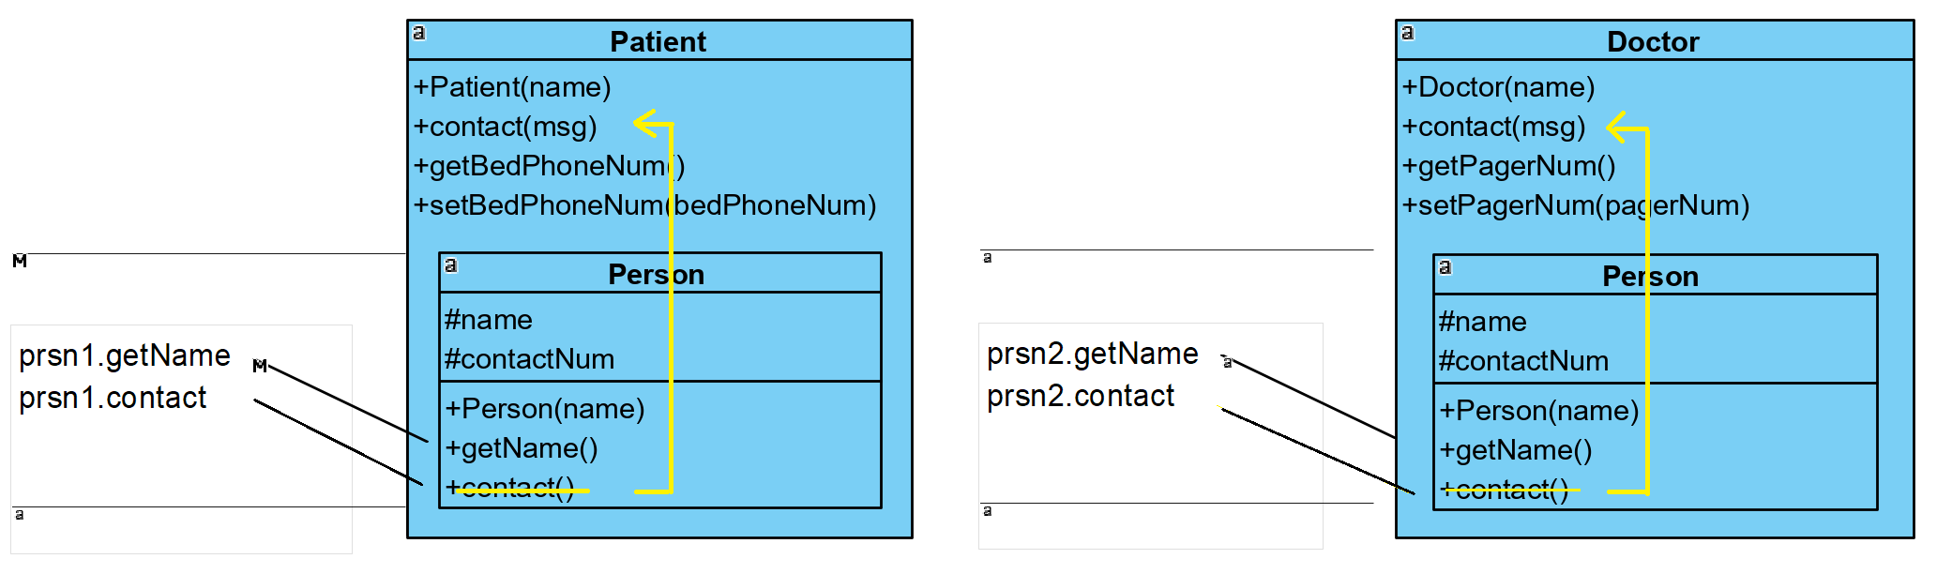
Subtype Polymorphism
Patient patient=new Patient("John Smith"); Doctor doctor=new Doctor("Dr. Bob Nettles"); Person prsn1=(Person)patient; Person prsn2=(Person)doctor;

Slide 7
Subtype Polymorphism
Patient patient=new Patient("John Smith"); Doctor doctor=new Doctor("Dr. Bob Nettles"); Person prsn1=(Person)patient; Person prsn2=(Person)doctor;
ArrayList<Person> persons=new ArrayList<Person>(); persons.add(prsn1); persons.add(prsn2); for(Person p:persons){ System.out.println(p.getName());
p.contact(“Hospital is closing”); }

Slide 8
Ad hoc Polymorphism
Method or operator overloading
public int add(int a, int b) {
return a+b; // returns the numeric sum of a and b
}
public double add(double a, double b) {
return a+b; // returns the numeric sum of a and b
}
public String add(String a, String b) {
return a+b; // returns the concatenation of a and b
}

Slide 9
Parametric Polymorphism
‘Generics’
Generic classes manipulate object references without knowing, or needing to know what class of objects they refer to.
We tell the generic classes what specific objects they is working with
Don’t work with primitive types.
ArrayList<String> list = new ArrayList<String>(); list.add("hello");
ArrayList<Patient> pats = new ArrayList<Patient>(); pats.add(new Patient("John Smith"));

Slide 10
Abstraction
Hiding as much of the specific and concrete implementation detail of your class as possible and making available only the essential features
To reduce complexity
Abstraction is a broader principle than the other three
Examples include:-
Methods
Private and protected fields
Subtype polymorphism

Slide 11
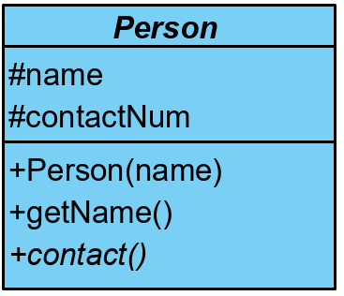
‘abstract’ classes and methods
The keyword ‘abstract’ strongly encourages subtype abstraction
‘abstract’ methods have no concrete implementation and must be overridden when being inherited
A class is ‘abstract’ if it has at least one abstract method - and therefore can’t be instantiated
public abstract class Person { protected String name; protected String contactNum; public Person(String name) { this.name = name; } public String getName() { return name; }
public abstract void contact(String msg);
}

Slide 12
‘abstract’ classes and methods
The keyword ‘abstract’ strongly encourages abstraction by subtype polymorphism
‘abstract’ methods have no concrete implementation and must be overridden when being inherited
A class is ‘abstract’ if it has at least one abstract method - and therefore can’t be instantiated
Inheriting classes must provide a concrete implementation
public abstract class Person { protected String name; protected String contactNum; public Person(String name) { this.name = name; } public String getName() { return name; }
public abstract void contact(String msg);
}

Slide 13
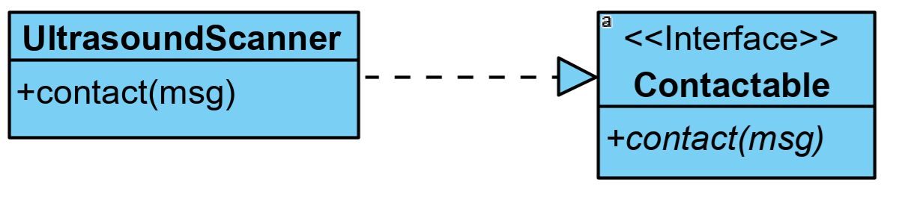
Interfaces
Interfaces are classes where:-
all methods are abstract and have no implementation
all fields are public, static and final – there are no instance fields.
Classes ‘implementing’ interfaces must provide concrete implementations for all of its methods
public interface Contactable { public void contact(String message); }
public class UltrasoundScanner implements Contactable{ public void contact(String message) { USScannerSystem.log(message); } }

Slide 14
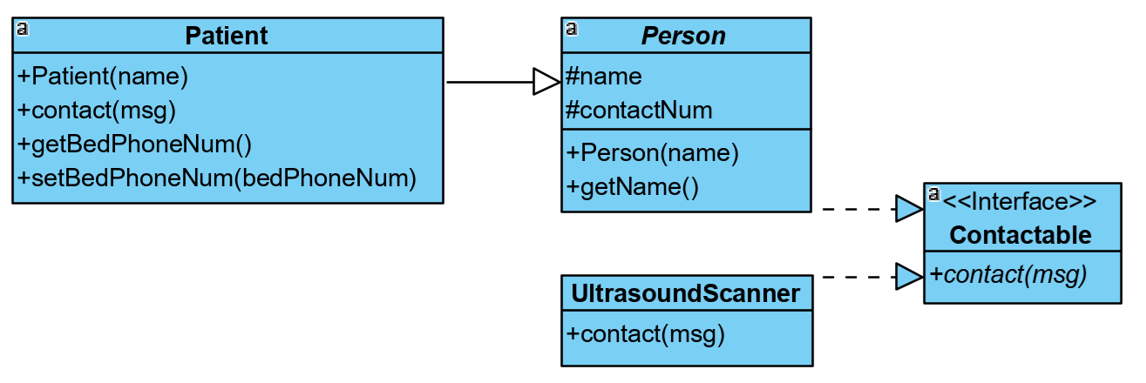
Interfaces
Interfaces define a contract or blueprint for a specific behaviour that the class must then implement in its own specific way
public abstract class Person implements Contactable { protected String name; protected String contactNum; public Person(String name) { this.name = name; } public String getName() { return name; } }

Slide 15
Interfaces
Interfaces enable subtype polymorphism between objects that aren’t linked by inheritance
Patient pat1=new Patient("John Smith"); UltrasoundScanner us1=new UltrasoundScanner();
ArrayList<Contactable> contactList=new ArrayList<Contactable>(); contactList.add(pat1); contactList.add(us1);
for(Contactable c:contactList) { // Subtype polymorphism c.contact("There is a hospital power outage."); }

Slide 16
Interfaces
A class can extend only one other class, but can implement as many interfaces as it wants
(actually an interface can have static methods!)
public class UltrasoundScanner extends Scanner implements Contactable, Rebootable{ public void contact(String message) { USScannerSystem.log(message); }
public void reboot() { USScannerSystem.reboot(); } }

Slide 17
Anonymous classes
Subclasses with no name for one-off use
Defines an anonymous subclass which inherits from Person.
Provides the concrete implementation of the abstract method ‘contact’.
Instantiate an object of that anonymous subclass, passing ‘John Smith’ into the constructor.
Add the ‘Person’ view of that object to the list ‘people’ – ie using polymorphism.
ArrayList<Person> people=new ArrayList<Person>();
people.add(new Person("John Smith"){ public void contact(String message) { System.out.println(message); } });

Slide 18
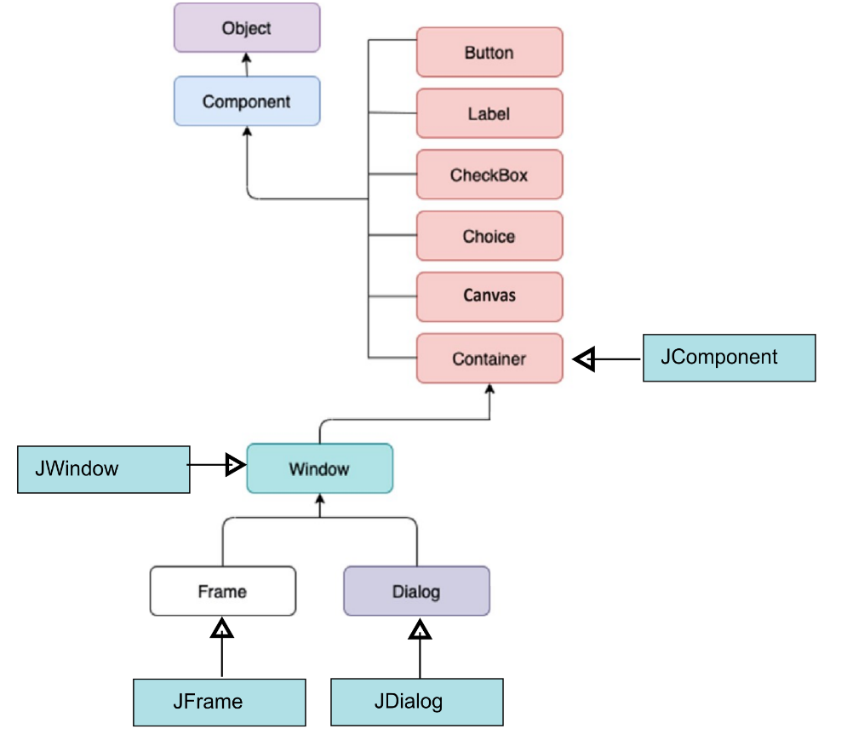
SWING

Slide 19
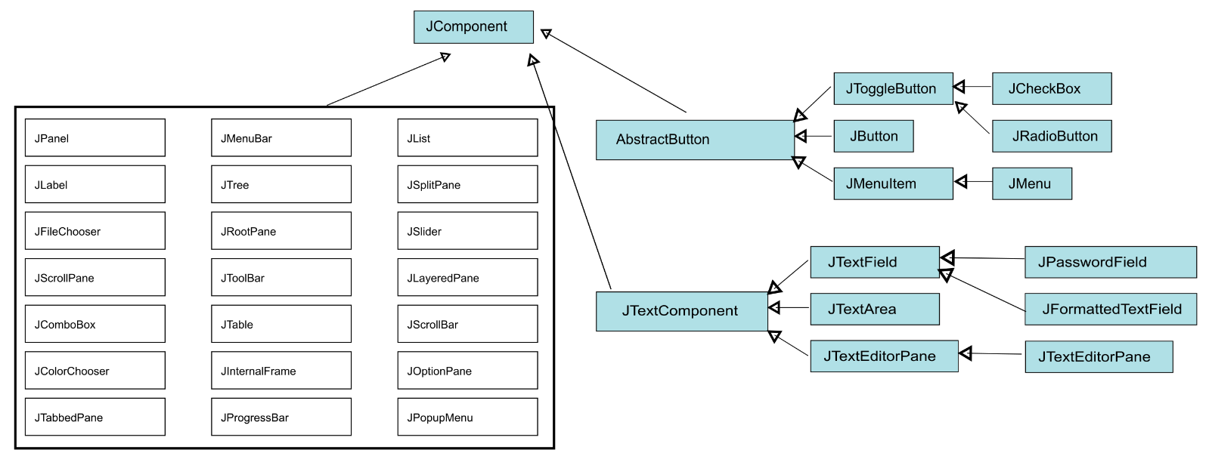
SWING
https://web.mit.edu/6.005/www/sp14/psets/ps4/java-6-tutorial/components.html

Slide 20
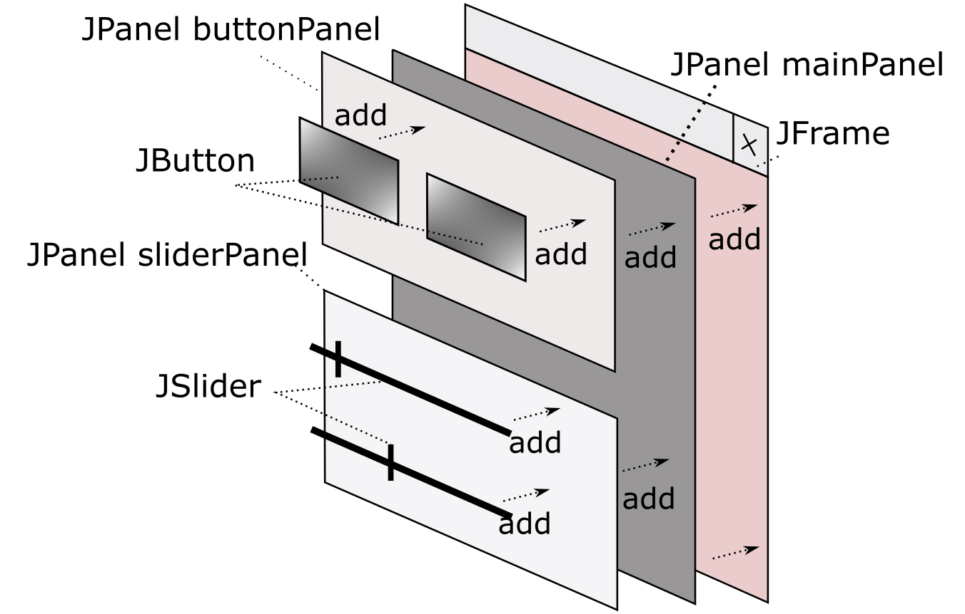
SWING
https://docs.oracle.com/javase/tutorial/uiswing/layout/visual.html

Slide 21
SWING – anonymous classes examples
frame.addWindowListener(new WindowAdapter() {
public void windowClosing(WindowEvent e) {
frame.dispose();
}
});
JButton but1=new JButton(“Press me”);
ActionListener but1AL=new ActionListener() { public void actionPerformed(ActionEvent e) { System.out.println("Button 1 pressed "+e.getActionCommand());
}
};
but1.addActionListener(but1AL);

Slide 22
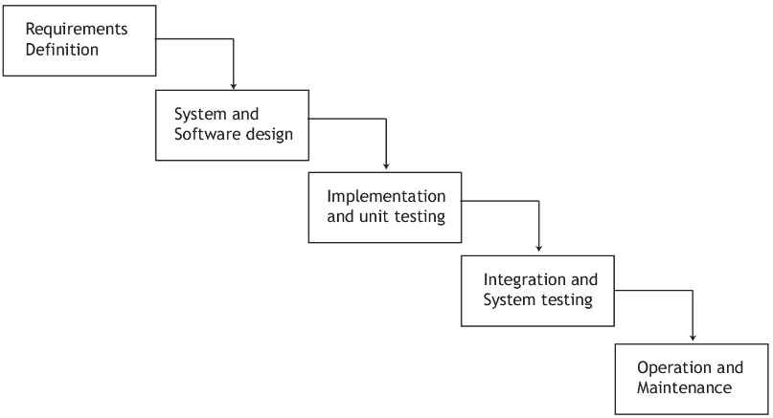
Software Project Lifecycles – Waterfall model

Slide 23
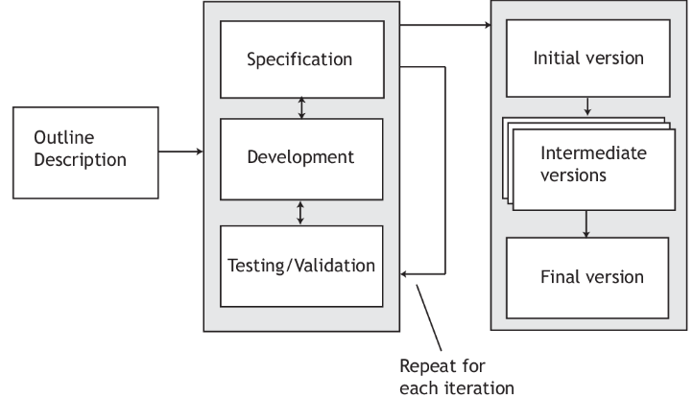
Software Project Lifecycles – Iterative model
User stories

Slide 24
Software Processes – Requirements Gathering
User stories
As a [specific type of user], I want [an outcome] so that [a reason]
As a doctor, I want messages to be paged to me so that I can read them when I am less busy.
As a blind patient, I want messages to be sent by voicemail because I can’t read text.
As an administrator, I want to send important messages to all people in the hospital

